Slide 1
Modelling Nuclear Decay
$N\left(t\right)≡$ number of nuclei at time t
$τ≡$ mean lifetime (half life)
$$\frac{dN}{dt}=−\frac{N(t)}{τ}$$
Fermat's Difference Quotient
$$\frac{dN}{dt}=\frac{N\left(t+Δt\right)−N(t)}{Δt}$$
$$−\frac{N(t)}{τ}=\frac{N\left(t+Δt\right)−N(t)}{Δt}$$
$$N\left(t+Δt\right)=N\left(t\right)−\frac{N(t)}{τ}Δt$$
This is Euler’s Method

Slide 2
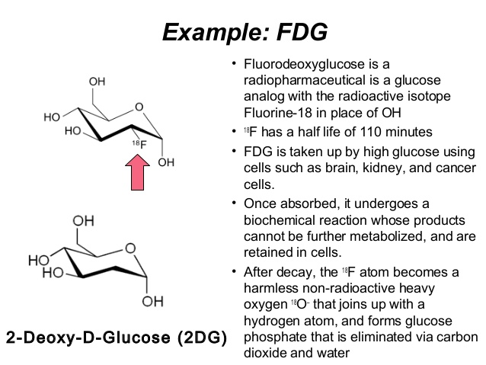
Fluorine-18

Slide 3
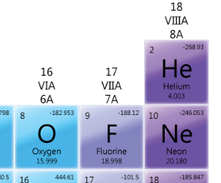
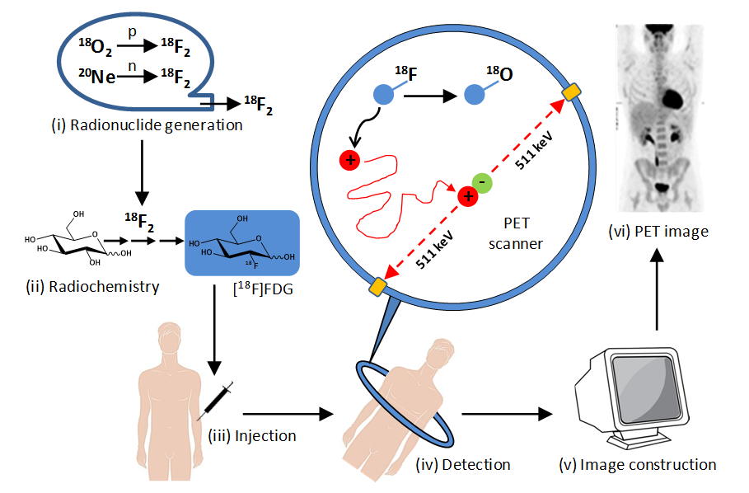


Fluorine-18
At least 5% of the injected Flourine-18 must still be present to be detected

Slide 4
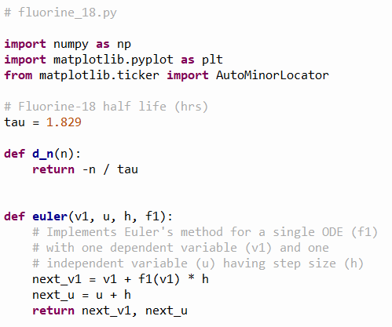

Open fluorine-18.py
①
②
$$\frac{dN}{dt}=−\frac{N(t)}{τ}$$
③
④
⑤
⑥

Slide 5
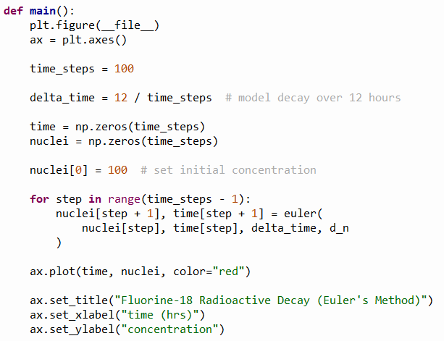
View fluorine-18.py
①
②
③
④
⑤
⑥
⑦
⑧

Slide 6
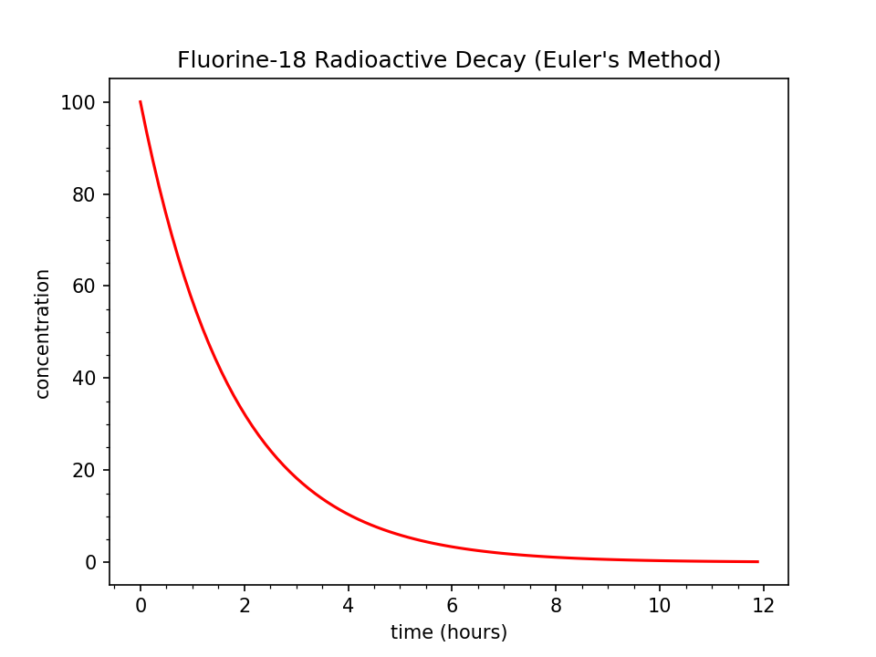
Run fluorine-18.py

Slide 7
Run fluorine-18.py
At least 5% of the injected Flourine-18 must still be present to be detected

Slide 8
Run fluorine-18.py
What two key concepts does this graph suggest?
After 12 hours the ingested Fluorine-18 has decayed enough to not be a lingering threat
Medical staff must get patients into the PET scan within ~5 hours after taking Fluorine-18
At least 5% of the injected Flourine-18 must still be present to be detected

Slide 9

Hidden Figures, Fox 2000 Pictures, 2016

Slide 10
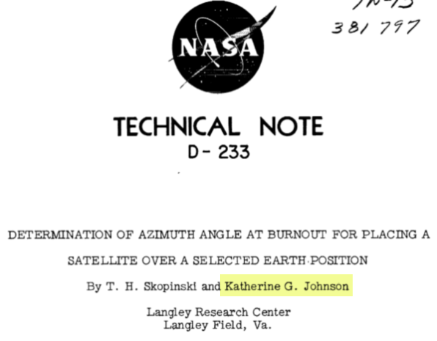
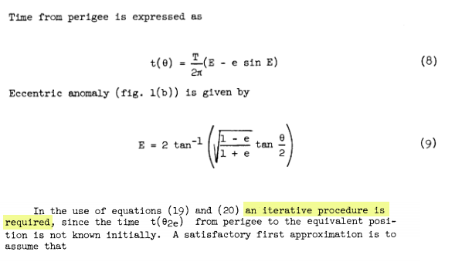
Hidden Figures, Fox 2000 Pictures, 2016
Euler’s Method

